Slide 1
TREADMILL DASHBOARD
GROUP 76
Group Members :
Zumreth Mohamed (E/18/226)
Dinuka Mudalige (E/18/227)
Heshan Munasinghe (E/18/228)

Slide 2
Project goals
Ability to make a basic operating system for a treadmill.
Defining and implementing proper functions in a code.
Improving coding skills and maintaining a proper program.
Ability to design a graphical user interface and present a basic treadmill dashboard.
Improving teamwork.

Slide 3
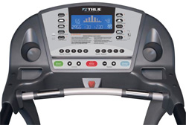
Introduction to the project.
The treadmill is widely used today by almost everyone in the world.
The program inside the treadmill dashboard consists of a series of complex coding that displays the outputs required by the user.
In this project, we designed a treadmill dashboard program that takes certain inputs from the user and displays the relevant outputs.

Slide 4
The project was done under three steps
Milestone 1
Milestone 2
Bonus Milestone
The program was designed using Python programming language.
Different equations were used in order to obtain the required outputs once the inputs were fed into the program.

Slide 5
Milestone 1
It is mainly based on designing a computer program to display - speed
- distance travelled
- no. of calories
- no. of steps taken by a treadmill user.
Milestone 1 covers up,
Functions needed for the calculation of the above parameters.
Relevant unit conversions to standard units.
A sample set of inputs that checks the values for the above parameters when the code runs.

Slide 6
Milestone 2
It is the real-time data visualization of Milestone 1.
The relevant input parameters are given to the program.
A timer will then automatically start and the output values will be displayed.
The speed is considered constant, but the distance travelled, number of calories burnt and the steps taken will vary with time.
The program runs until the system is aborted.

Slide 7
Bonus Milestone
The bonus milestone is mainly based on representing the treadmill dashboard program in a graphical user interface (GUI).
In the GUI representation there consists,
A welcome window
This window initiates the system. It also consists of a progress bar.
A data input window
It is in this window that all data are input into the system.

Slide 8
A dashboard window
This window displays all output values required by the user.
The above three representations make up the bonus milestone of our project.

Slide 9
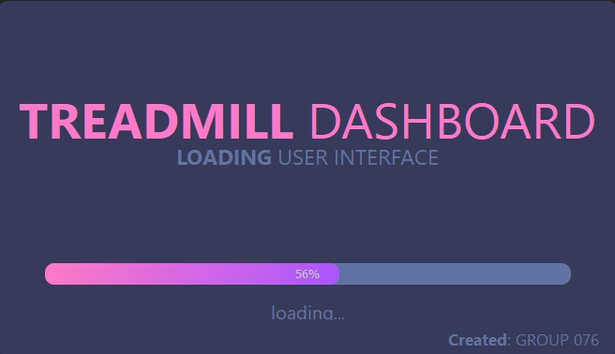
Screenshots of the GUI representation are given below.
The welcome window

Slide 10
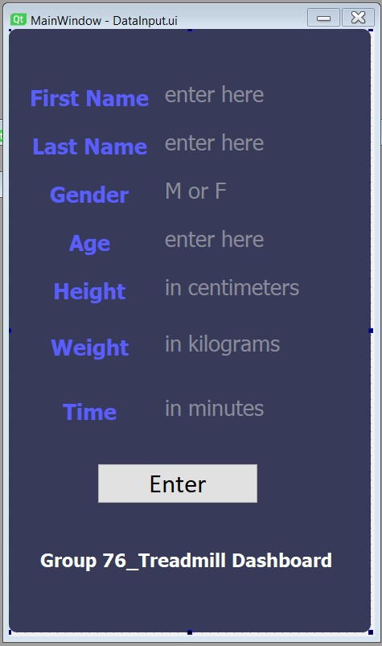
The data input window

Slide 11
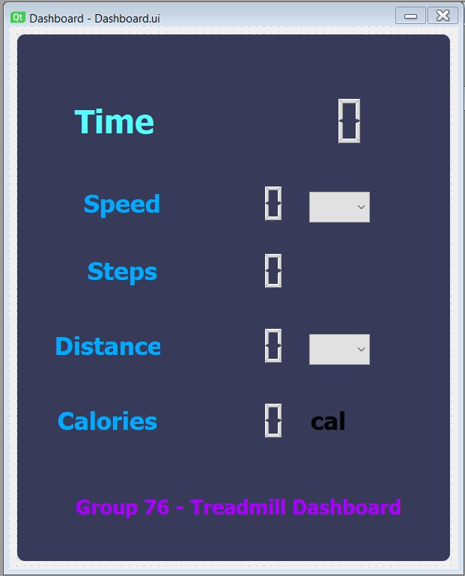
The dashboard window

Slide 12
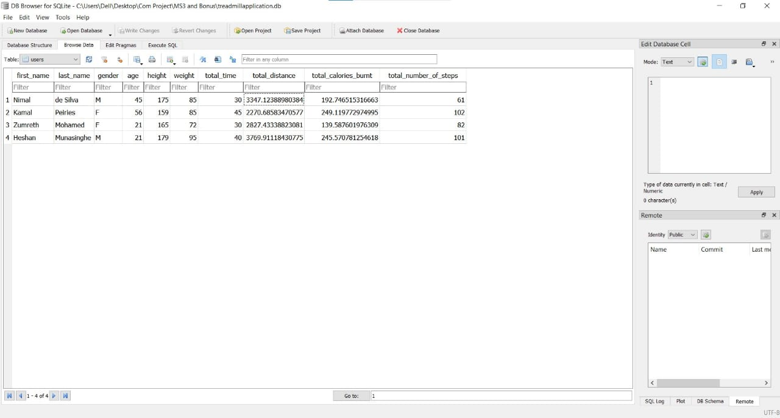
Here are some of the sample data and their corresponding results that were obtained.

Slide 13
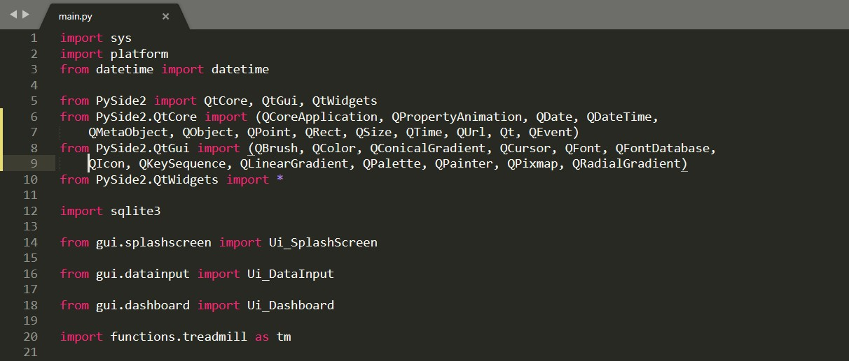
The relevant coding are represented below.

Slide 14
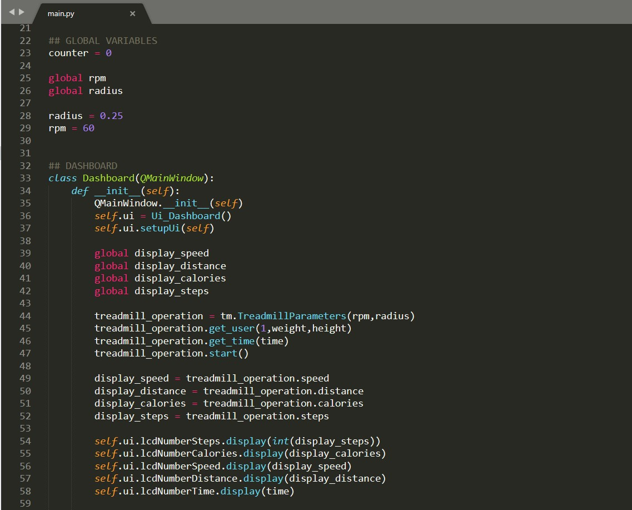

Slide 15
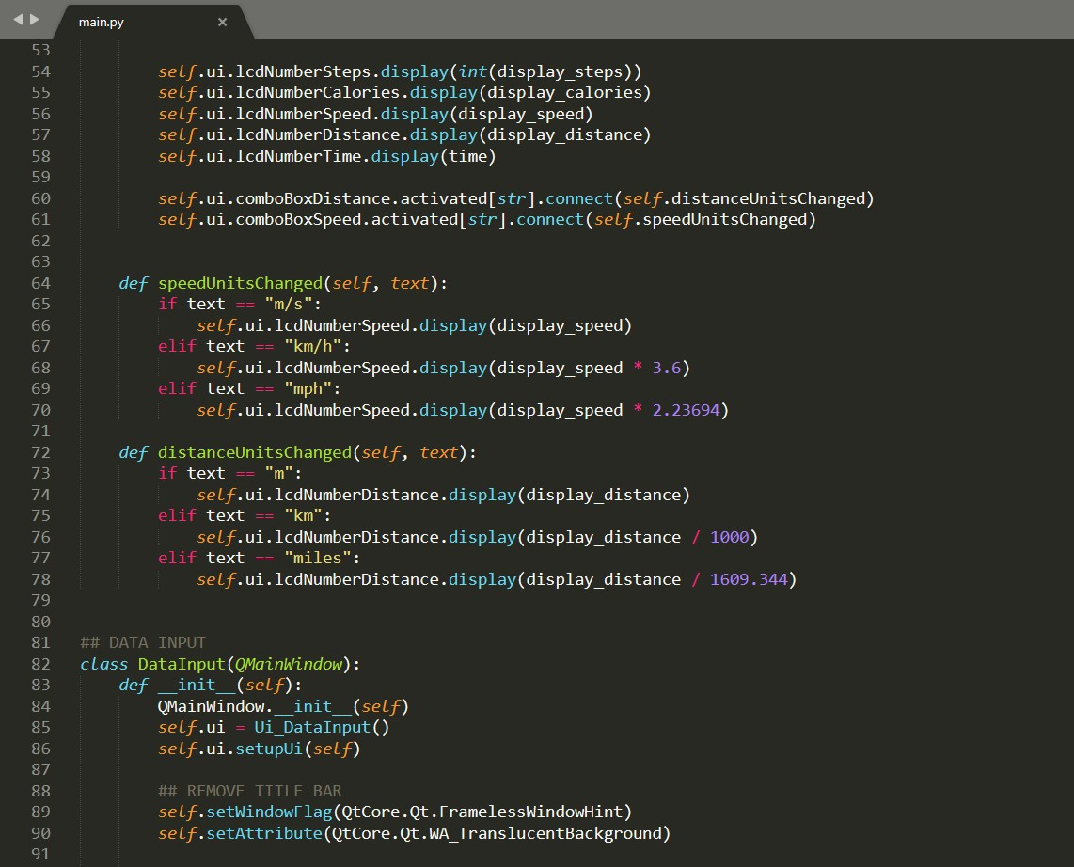

Slide 16
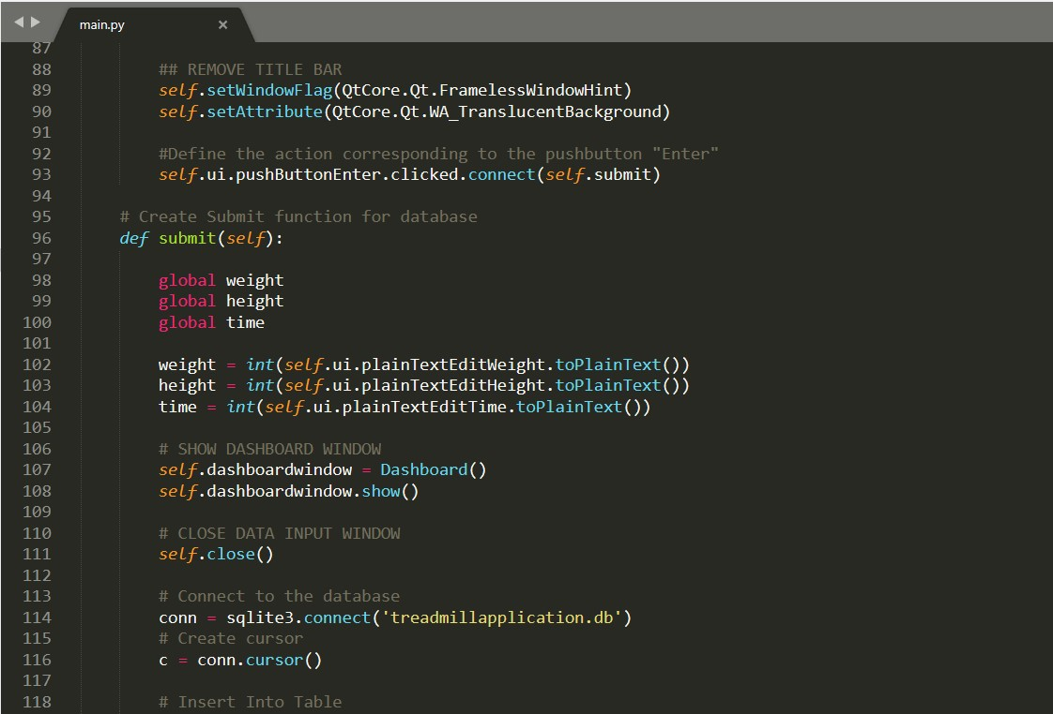

Slide 17
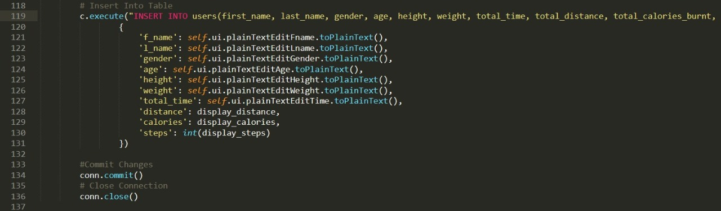
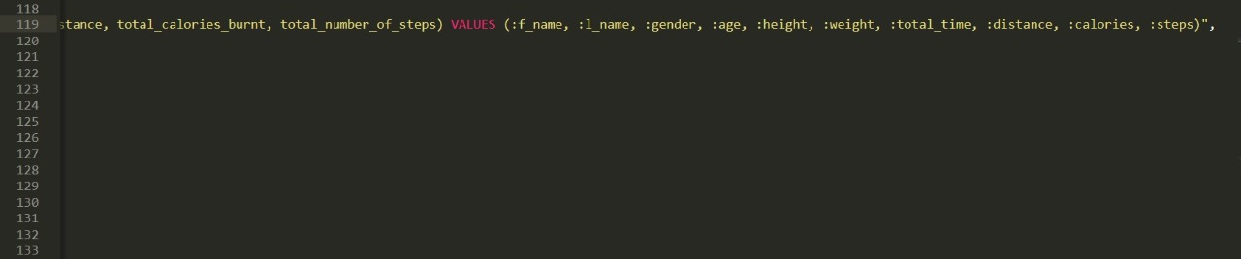

Slide 18
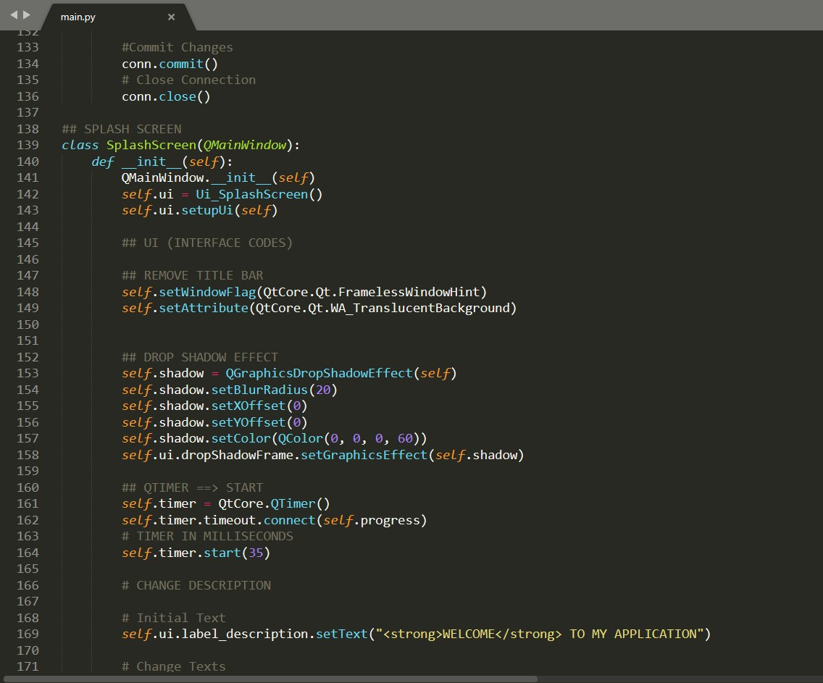

Slide 19
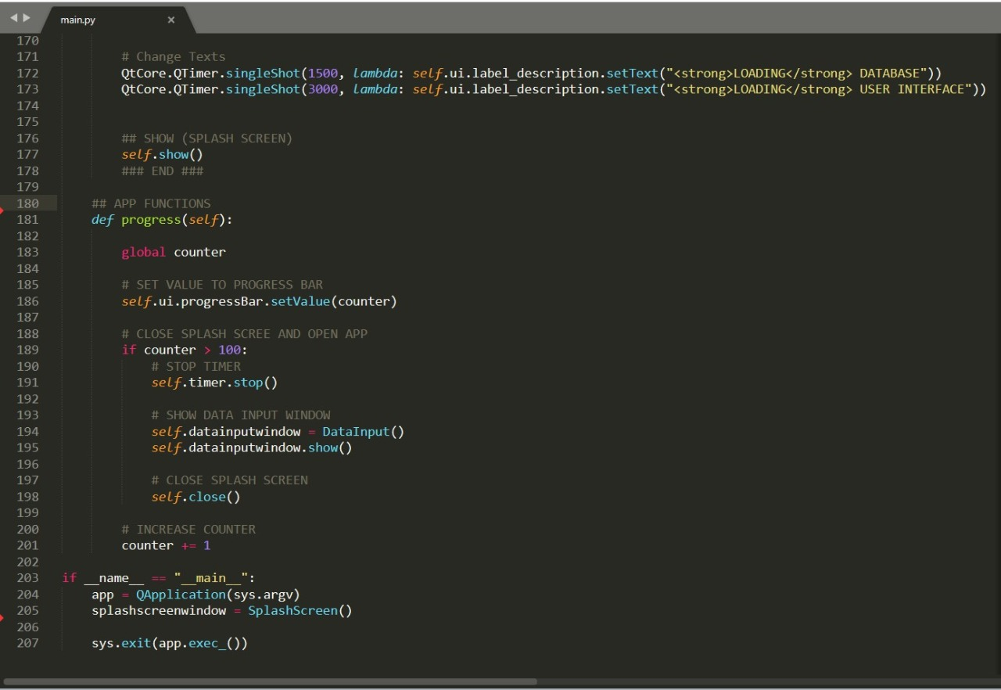

Slide 20
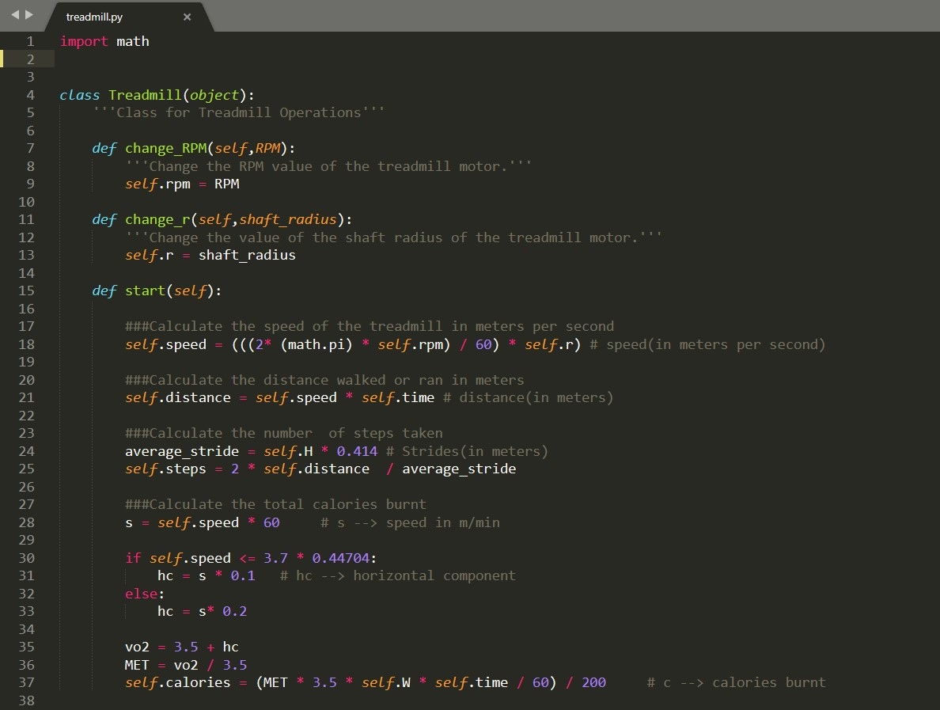

Slide 21
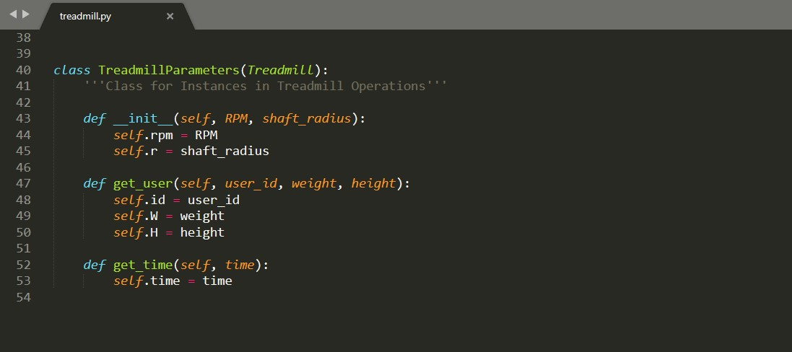

Slide 22
Individual contribution
All members contributed greatly in an equal manner to complete the project successfully.
Considering the contribution being ranked from 1 to 5 where 1 being the lowest and 5 being the highest,
the contribution of each member,
Zumreth (E/18/226) – 5
Dinuka (E/18/227) – 5
Heshan (E/18/228) – 5

